Slide 1
ERD Examples

Slide 2
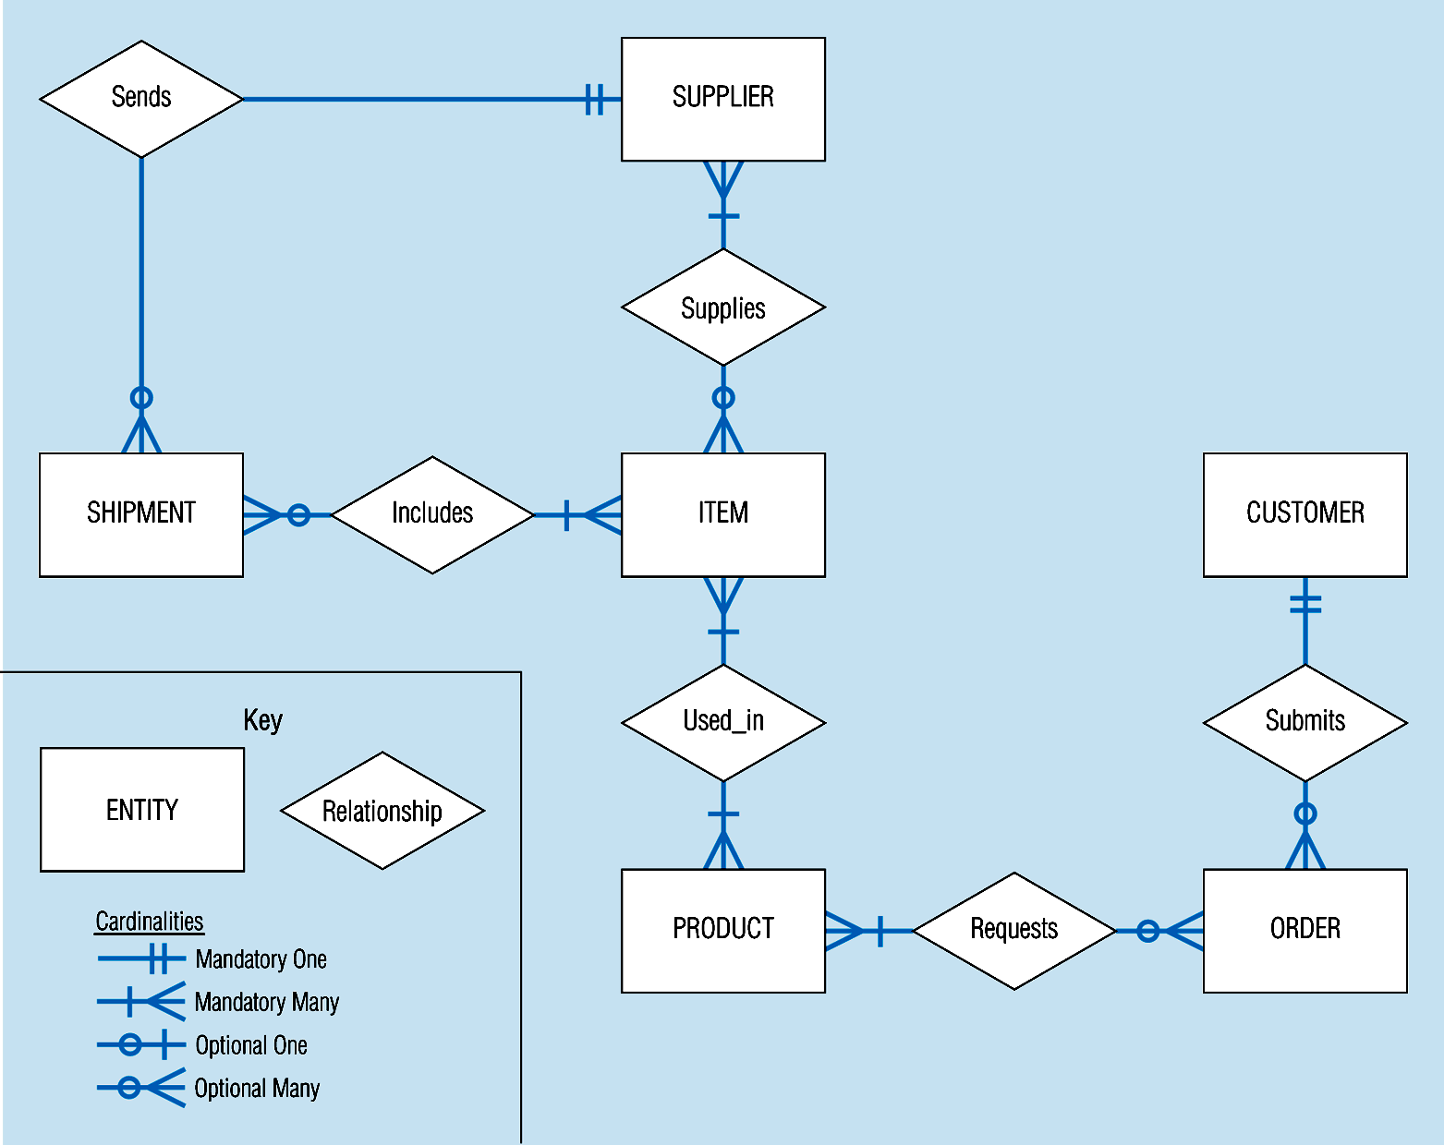

Slide 3
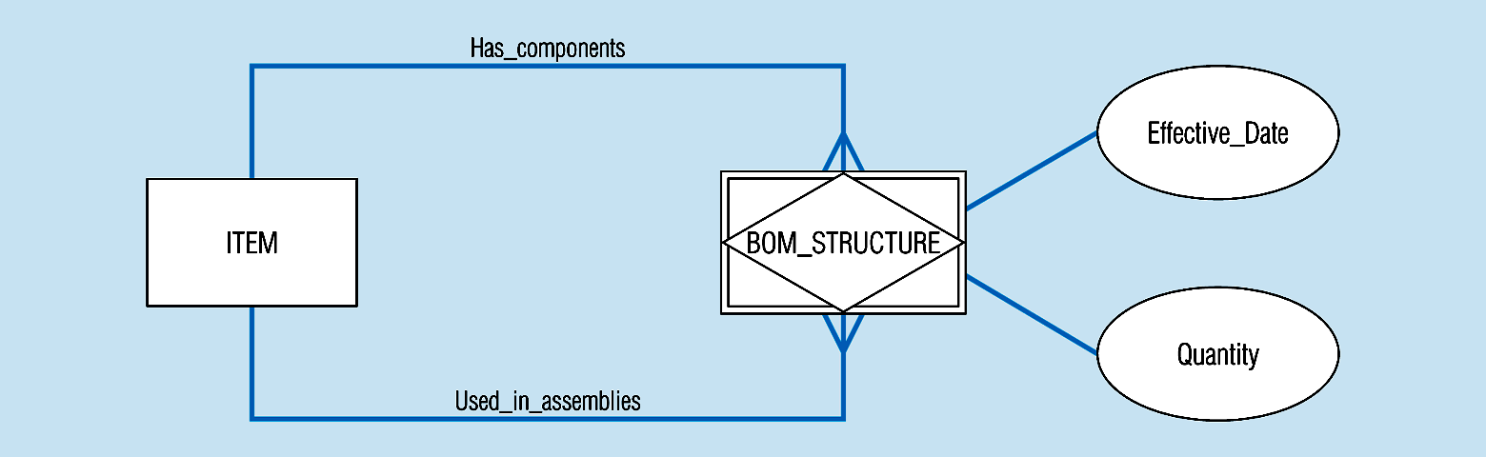
Associative entity

Slide 4
Example 1
A company has a number of employees. The attributes of EMPLOYEE include Employee_ID, Name, Address, and Birthdate. The company also has several projects. Attributes of PROJECT include Project_Id, Project_Name, and Start_Date. Each employee may be assigned to one or more projects, or may not be assigned to a project. A project must have at least one employee assigned, and may have any number of employees assigned. An employee’s billing rate may vary by project and the company wishes to record the applicable billing rate for each employee when assigned to a particular project.

Slide 5
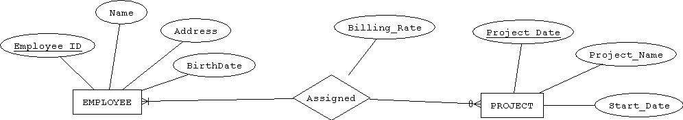

Slide 6
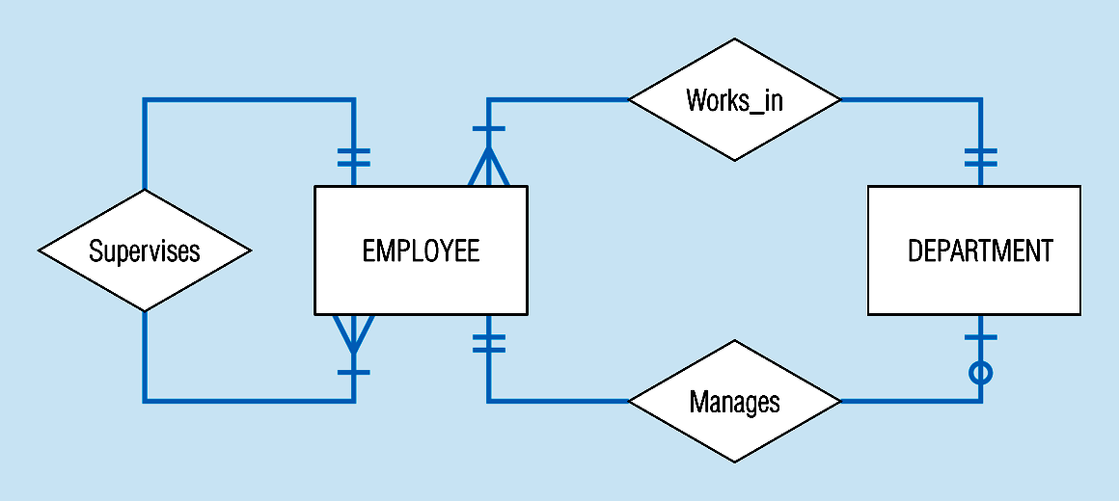
Examples of multiple relationships – entities can be related to one another in more than one way

Slide 7
